Slide 1
The Bluest Eye
By Toni Morrison

Slide 2
Unit Overview
4 10 pt quizzes
5 discussion questions and answers
10 significant quotations
A 2 page essay using text and at least 2 sources from Questia (50 pts.)

Slide 3
Calendar Week 1 Week 2
Mon.--Autumn quiz
Tues.—Defining beauty-- “Killing Us Softly 4”
Wed. Reading day
Thursday.—Discussion for “Winter”
Friday—Film Fest
Sat—AP Practice Test
Mon.—Discussion for “Spring”
Tues.—Research day/conference
Wed.—Research day/conference
Thurs.—Discussion for “Summer”
Fri.—Work day
Mon.—Essay due

Slide 4
Background
Morrison—Nobel prize winning author
Novel set in Lorain, Ohio, 1940’s
Published in 1970, Morrison’s first novel
Novel is gaining increasing attention from critics

Slide 5
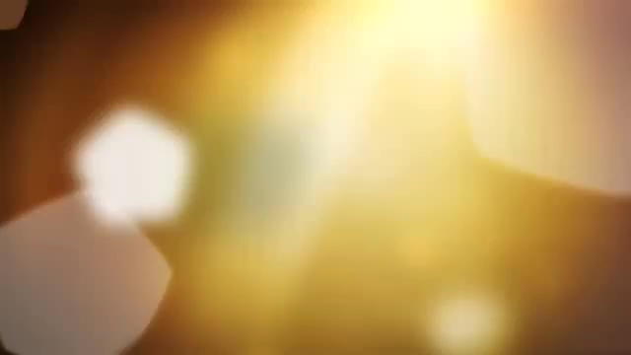
Toni Morrison

Slide 6
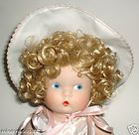
Jane Withers doll

Slide 7
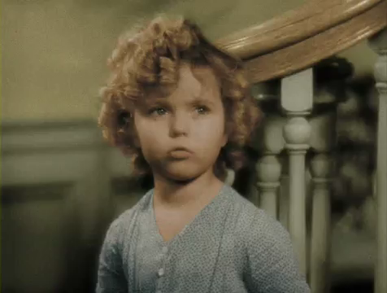
Shirley Temple

Slide 8
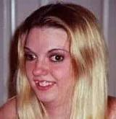
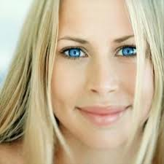
Who is more beautiful?
A
B

Slide 9
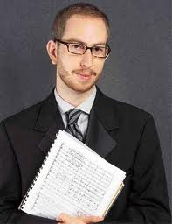
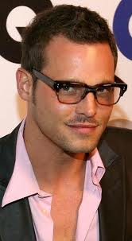
A or B?
A
B

Slide 10
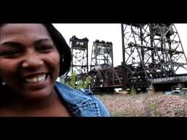
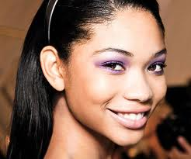
A or B?
A
B

Slide 11
Previewing Questions
Does media define beauty or does media reflect back what society sees as beautiful?
What, if anything, would make you more beautiful?
How much does the right clothes, hair cut, etc. make a person beautiful?
What advantages do “beautiful” people have?
How can we change the emphasis from outward beauty to inward beauty?

Slide 12
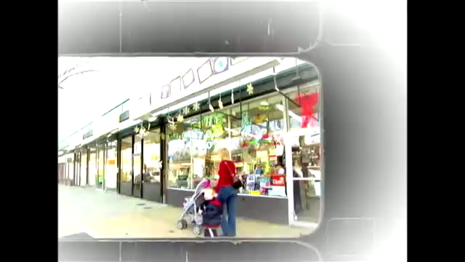

Slide 13
Body Image: Killing Us Softly

